Slide 1
PHYS 221 Recitation Quiz
Kevin Ralphs
Week 9

Slide 2
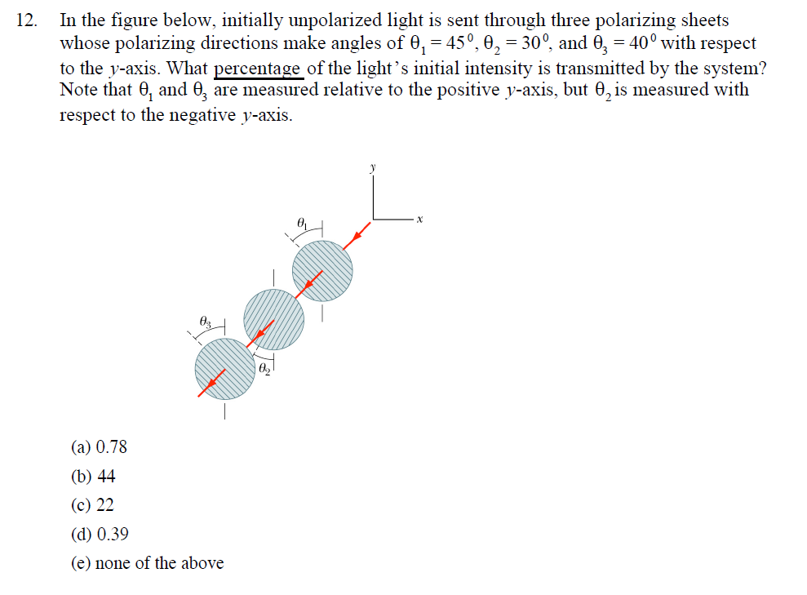
Quiz Question

Slide 3
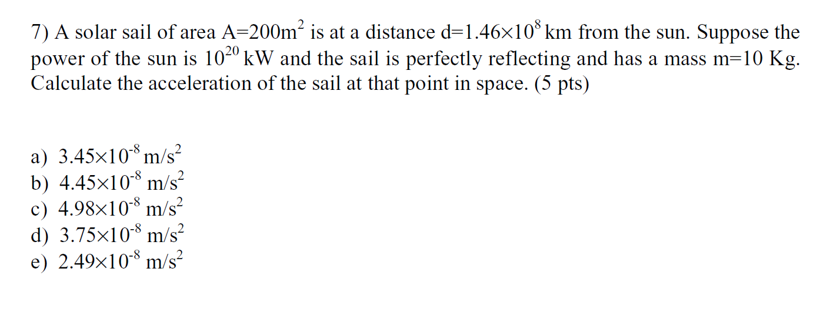
Quiz Question

